Slide 1
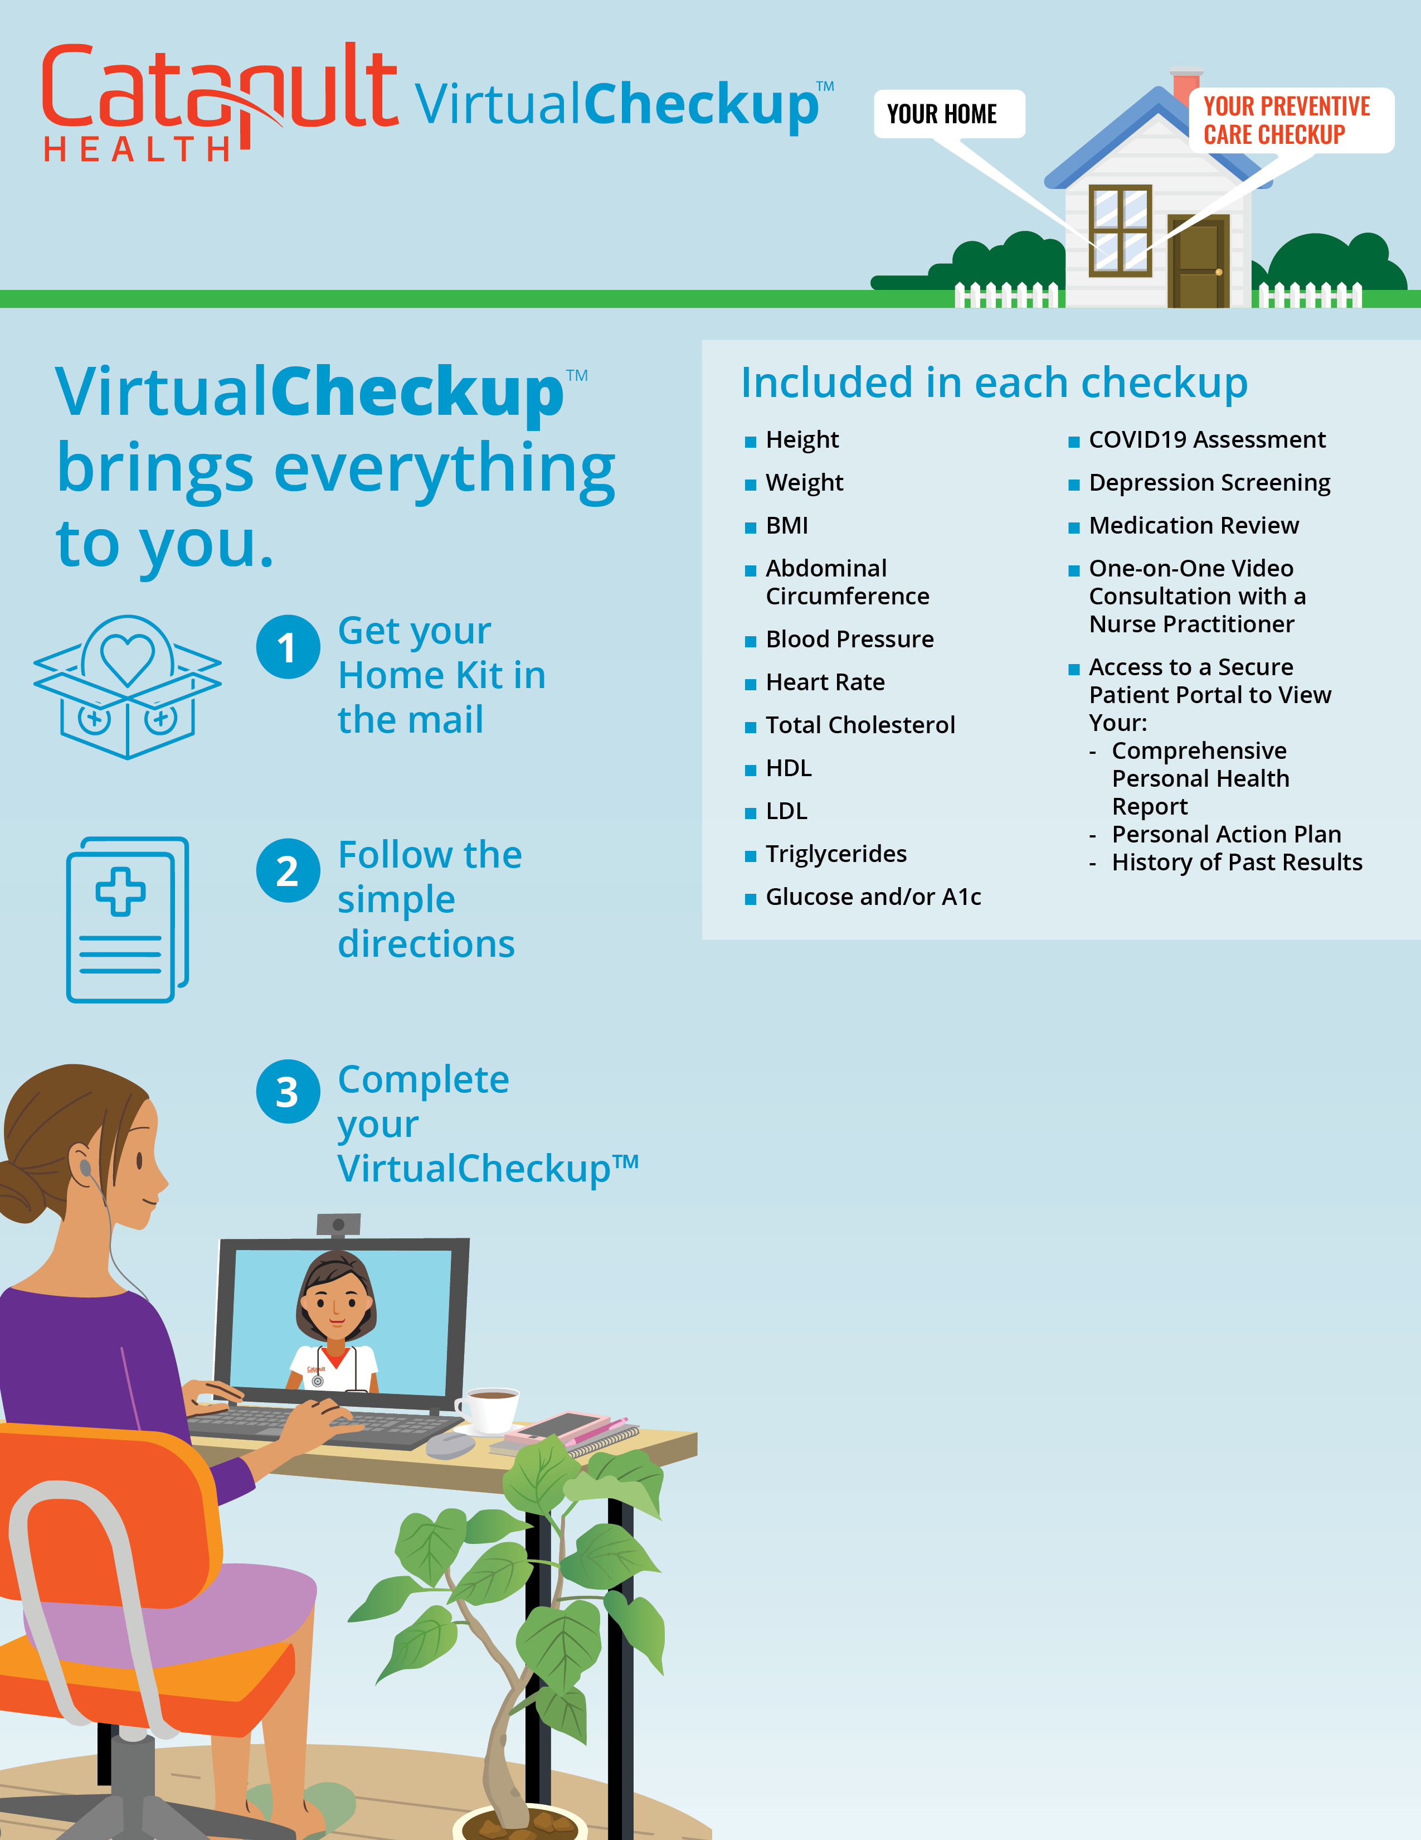
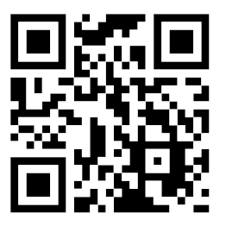
Request your Home Kit beginning
[enter launch date here]
Who’s eligible? [Enter eligibility text in this section.]
Why participate? Getting a health checkup has never been easier! Know your health status related to diabetes, heart disease and stroke. Review your results with a board-certified Nurse Practitioner via virtual consultation and develop a personal action plan.
When are Home Kits available? Request your Home Kit between [enter date here] and [enter date here].
How do I request A Home Kit? Go to VirtualCheckup.com/[Custom] or scan the QR code to register for your VirtualCheckup™ Home Kit.

