Slide 1
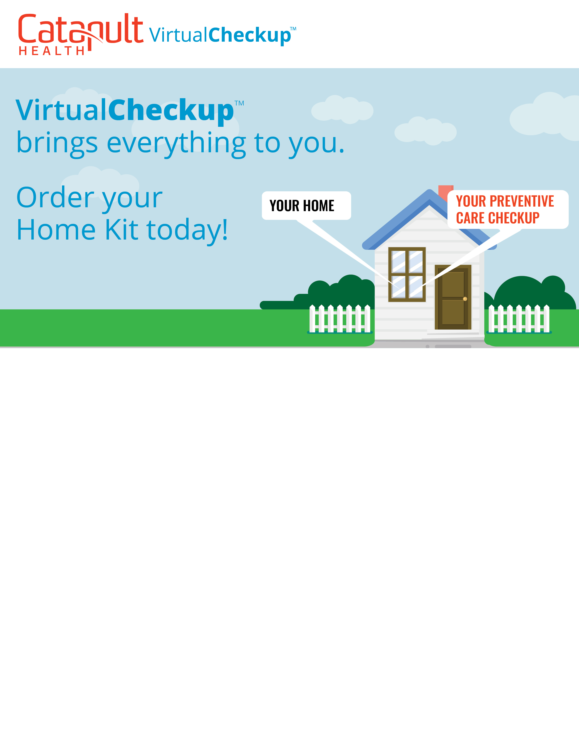
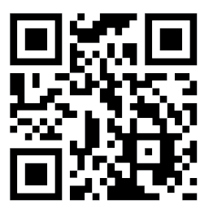




Request your Home Kit at VirtualCheckup.com/[Custom]
or scan the QR code. Act now! The last day to register for your VirtualCheckup™ Home Kit is [enter date here].
––––––––––––––– or –––––––––––––––
Schedule your Onsite Checkup, available at some of our work locations, by visiting TimeConfirm.com/[Custom].
Who’s eligible?
[Enter eligibility text in this section.]
Why participate?
Getting a health checkup has never been easier! Know your health status related to diabetes, heart disease and stroke. Review your results with a board-certified Nurse Practitioner via virtual consultation and develop a personal action plan.

