Slide 1
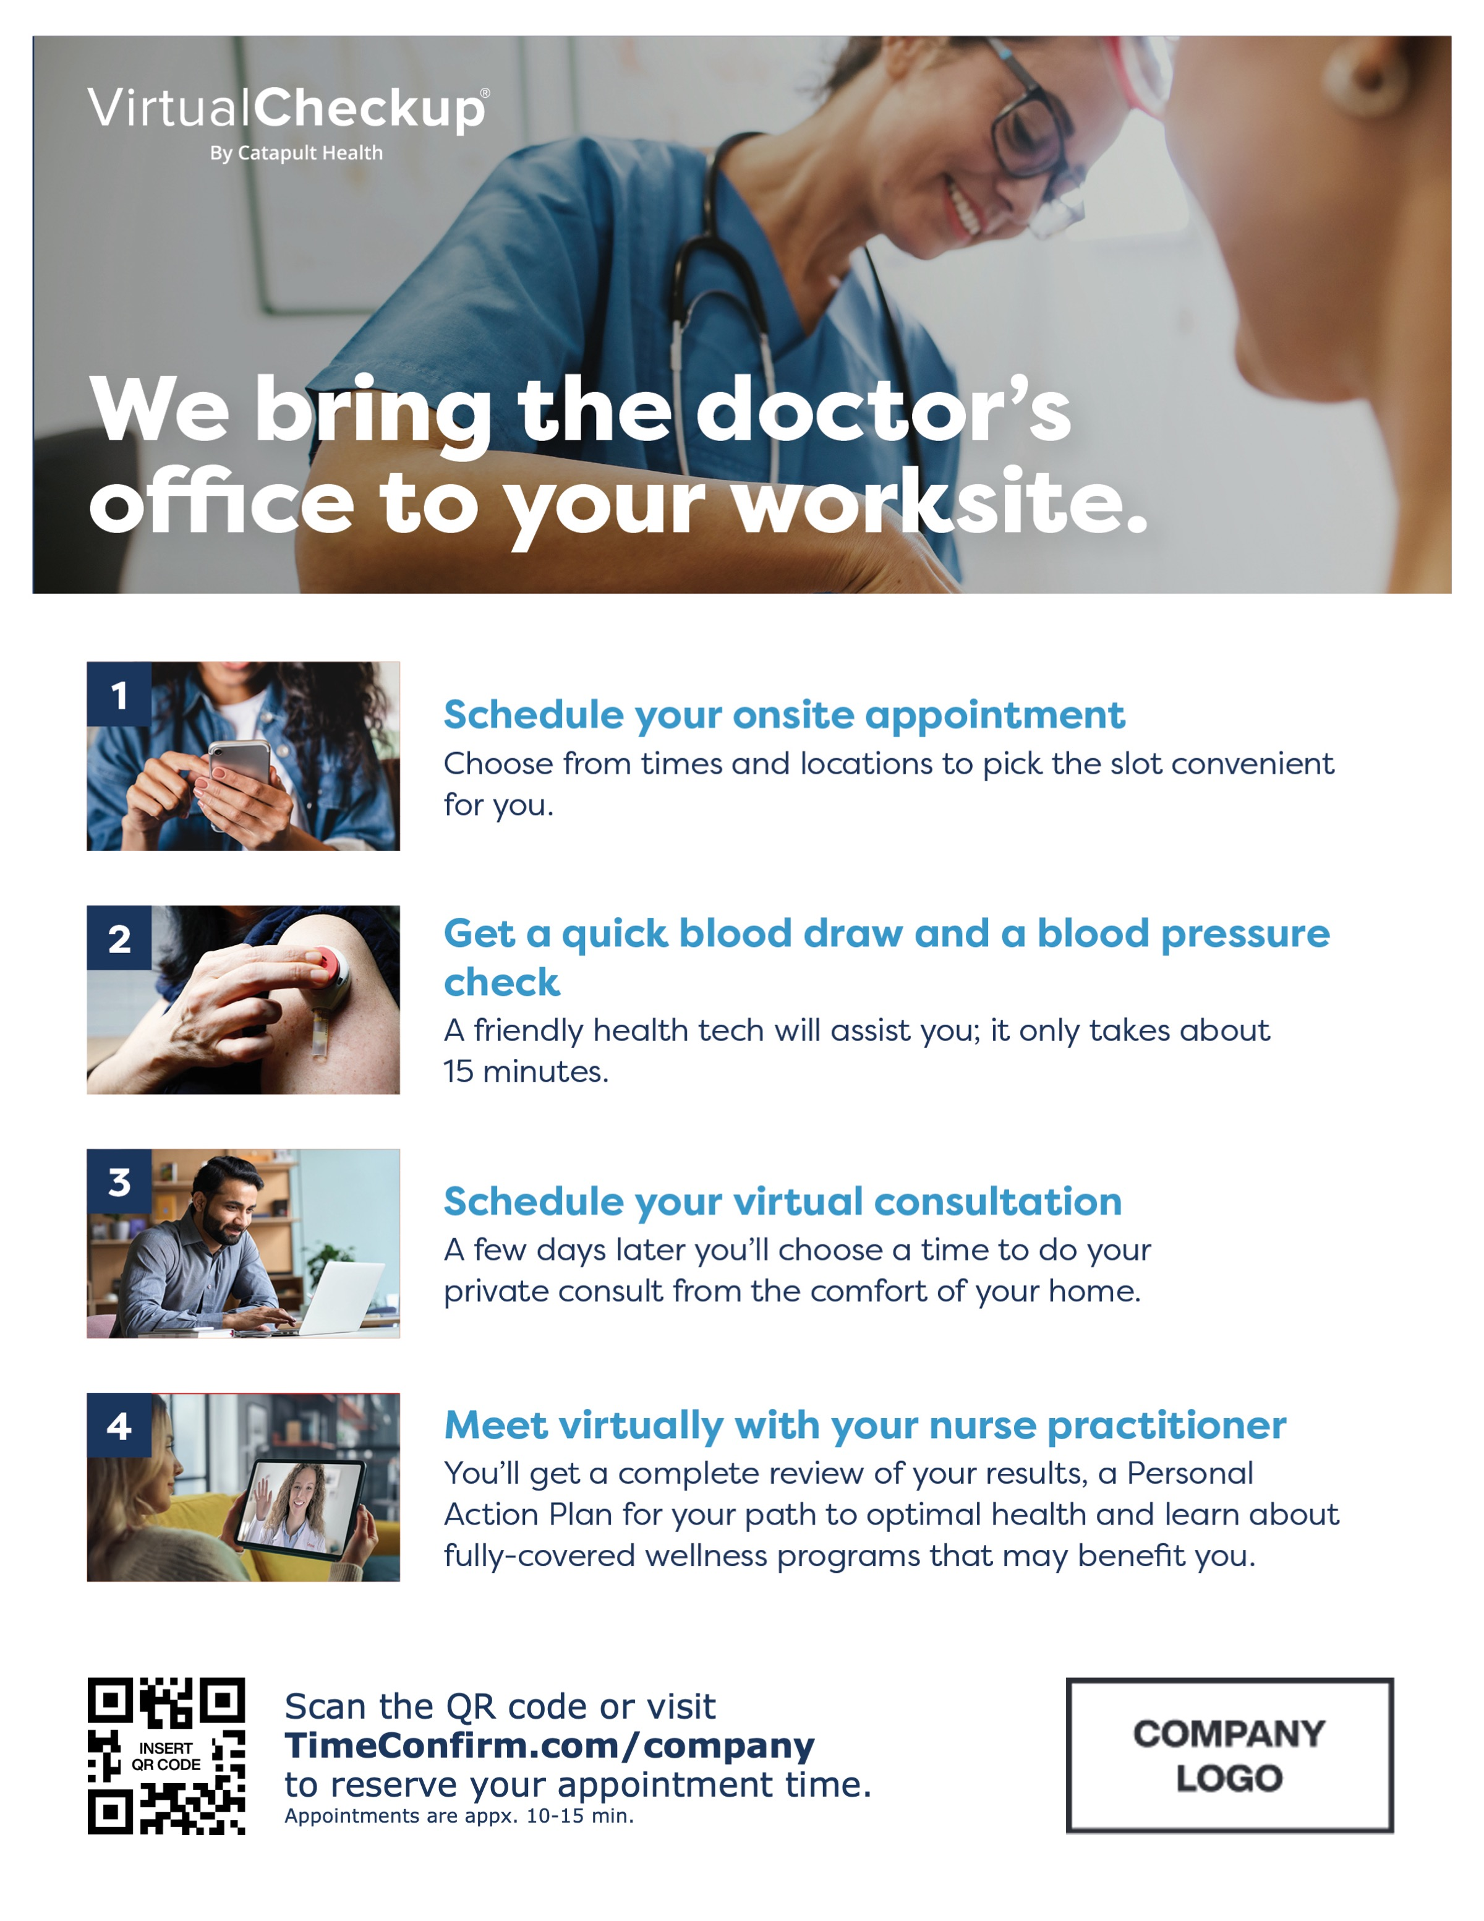
Onsite 4-Steps Flyer
v
v
v
Fonts: Verdana/Verdana Bold
Company logo: Best shown as PNG with transparent background
You may update several items marked in yellow including your logo, custom VirtualCheckup URL and QR code.
To best adhere to Catapult branding guidelines, text-based elements should use the Verdana font family.
V 01.25.23

Slide 2
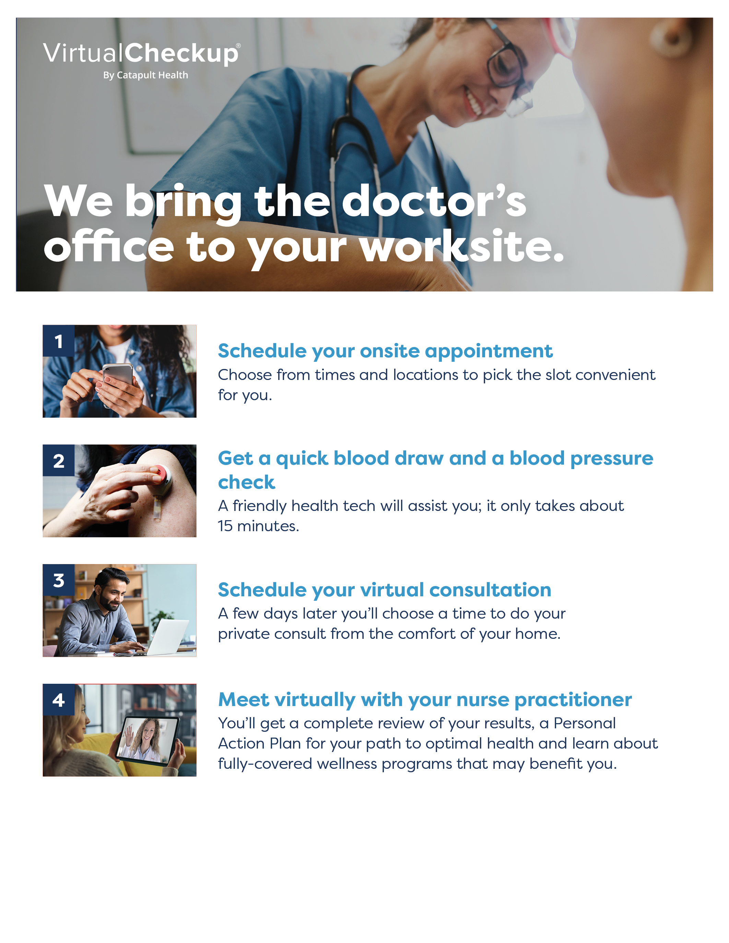
Scan the QR code or visit
TimeConfirm.com/company
to reserve your appointment time.
Appointments are appx. 10-15 min.

