Slide 1
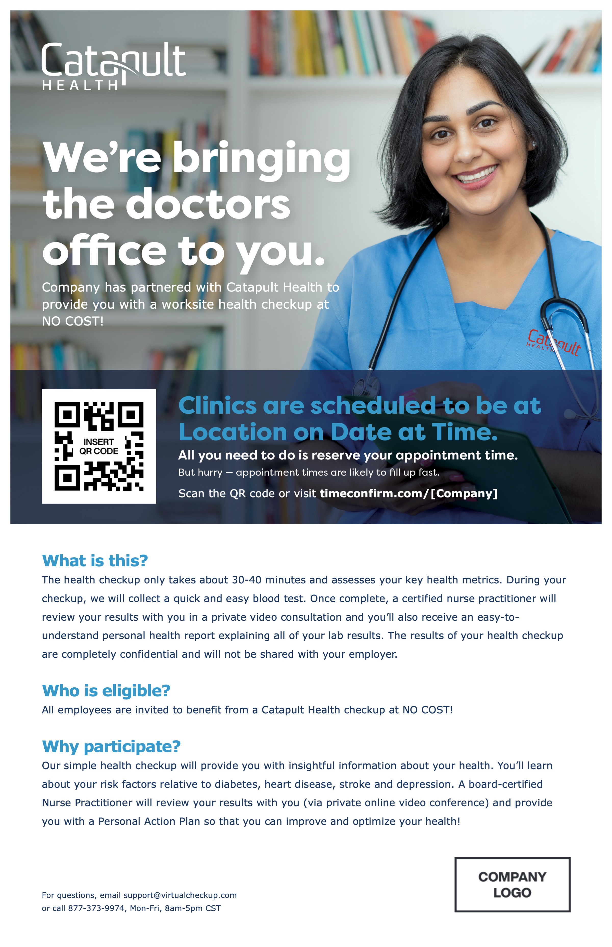
Onsite Poster
Fonts: Verdana/Verdana Bold
Company logo: Best shown as PNG with transparent background
You may update several items marked in yellow including your logo, custom VirtualCheckup URL and QR code.
To best adhere to Catapult branding guidelines, text-based elements should use the Verdana font family.
V 01.25.23

Slide 2
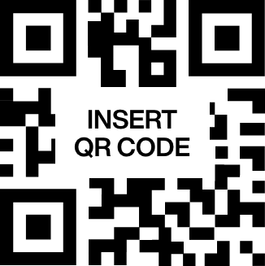
Company has partnered with Catapult Health to provide you with a worksite health checkup at NO COST!
Scan the QR code or visit timeconfirm.com/[Company]
What is this?
The health checkup only takes about 30-40 minutes and assesses your key health metrics. During your checkup, we will collect a quick and easy blood test. Once complete, a certified nurse practitioner will review your results with you in a private video consultation and you’ll also receive an easy-to-understand personal health report explaining all of your lab results. The results of your health checkup are completely confidential and will not be shared with your employer.
Who is eligible?
All employees are invited to benefit from a Catapult Health checkup at NO COST!
Why participate?
Our simple health checkup will provide you with insightful information about your health. You’ll learn about your risk factors relative to diabetes, heart disease, stroke and depression. A board-certified Nurse Practitioner will review your results with you (via private online video conference) and provide you with a Personal Action Plan so that you can improve and optimize your health!
For questions, email support@virtualcheckup.com
or call 877-373-9974, Mon-Fri, 8am-5pm CST

