Slide 1
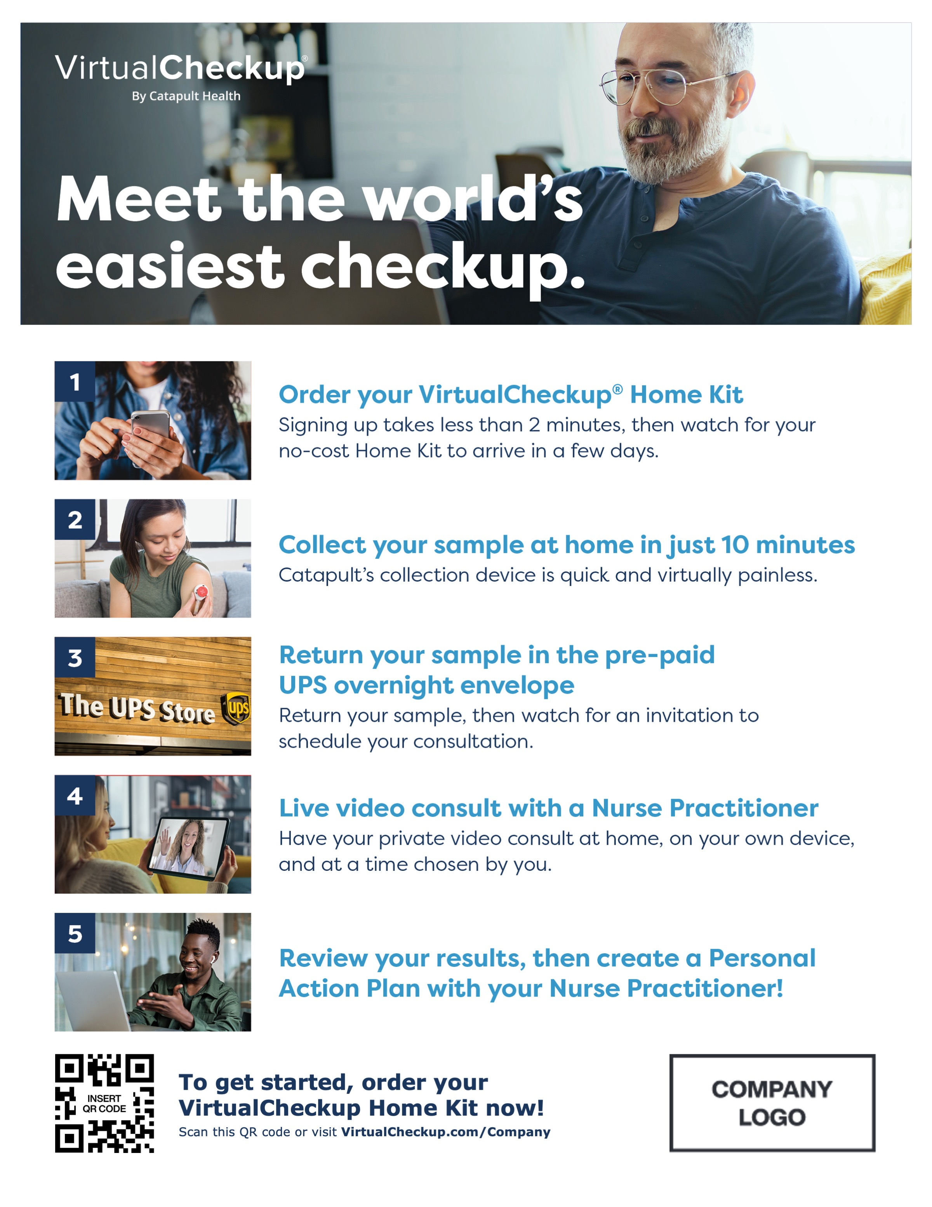
VirtualCheckup 5-Steps Flyer
v
v
v
Fonts: Verdana/Verdana Bold
Company logo: Best shown as PNG with transparent background
Each 8.5x11 Flyer features different models designed to help you promote inclusivity and best represent your population.
You may update several items marked in yellow including your logo, custom VirtualCheckup URL and QR code.
To best adhere to Catapult branding guidelines, text-based elements should use the Verdana font family.
V 01.25.23

Slide 2
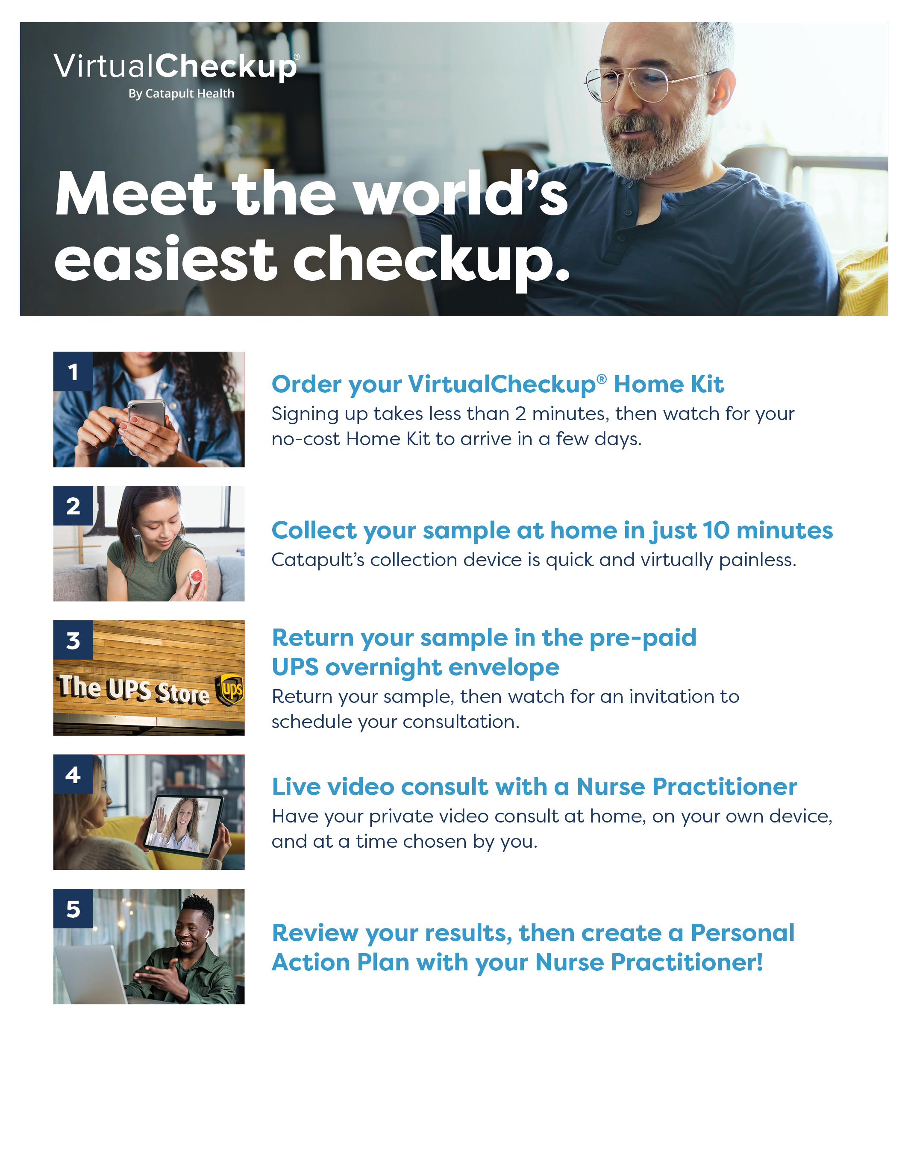
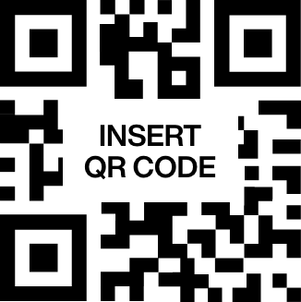
To get started, order your VirtualCheckup Home Kit now!
Scan this QR code or visit VirtualCheckup.com/Company

Slide 3
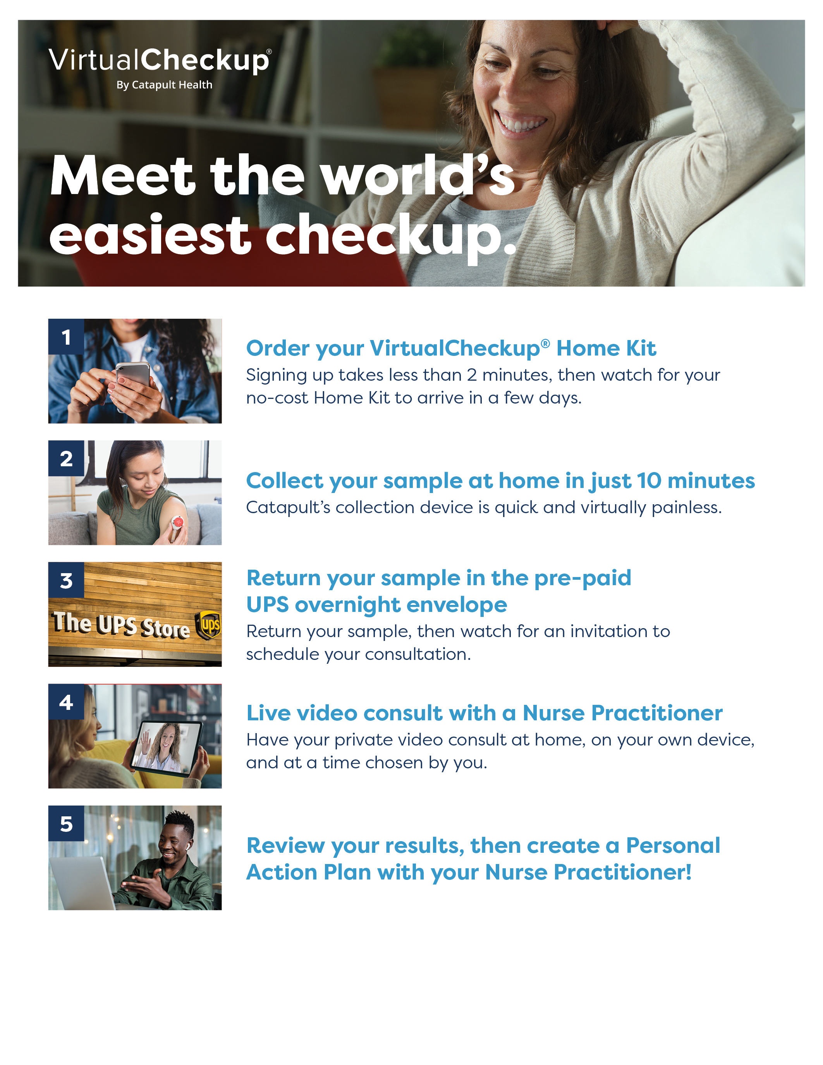
To get started, order your VirtualCheckup Home Kit now!
Scan this QR code or visit VirtualCheckup.com/Company

Slide 4
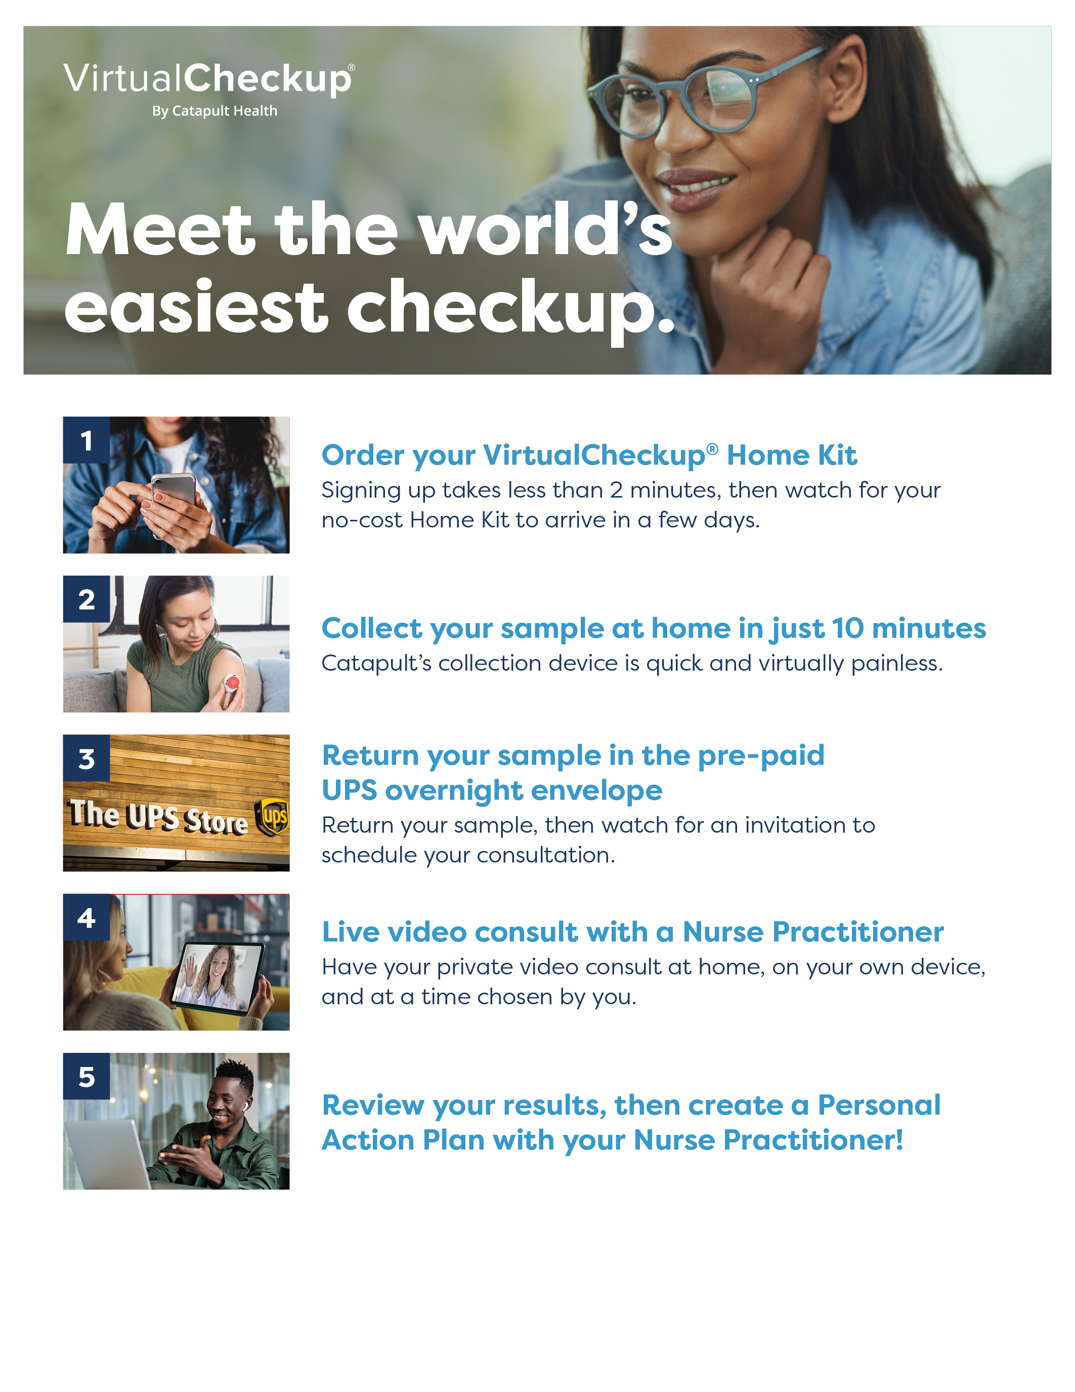
To get started, order your VirtualCheckup Home Kit now!
Scan this QR code or visit VirtualCheckup.com/Company

